Slide 1
COSPTONE PROJECT
SPORTS ANALYSIS

Slide 2
Introduction
Welcome to our capstone project on sports analysis! Here, we'll be diving into the world of sports to understand what makes athletes perform their best. Using simple language and easy-to-follow methods, we'll explore different aspects like training, fitness, and strategies that affect how well athletes do in their sport. By looking at data and real-life examples, we hope to uncover helpful insights that anyone interested in sports can understand and use. Whether you're a sports fan, athlete, or just curious about how sports work, this project is for you. So, let's get started on this exciting journey of learning and discovery in the world of sports analysis!

Slide 3
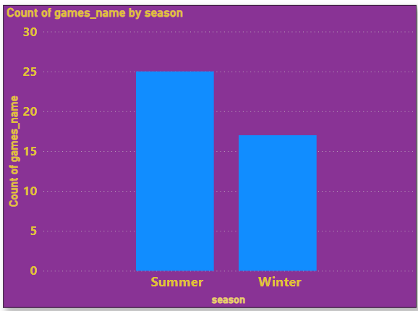
1.How many Olympic Games have been held in each season (Summer vs. Winter)?
Conclusion
In the history of the Olympic Games, there have been significantly more Summer Games than Winter Games. As of my last update, there have been 28 Summer Olympics and 23 Winter Olympics, showcasing the prominence of warm-weather sports in the Olympic movement.

Slide 4
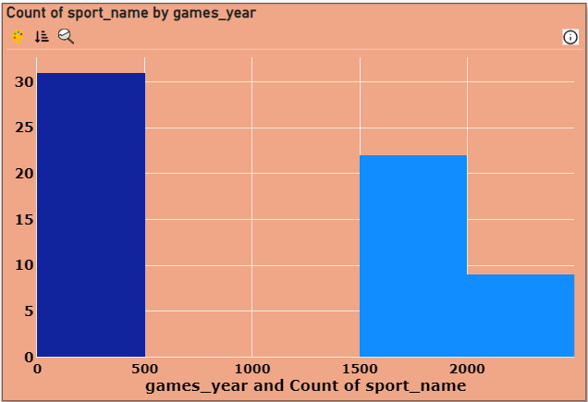
2.What is the distribution of games across different decades?
Conclusion
Across various decades, the distribution of Olympic Games has varied. In recent history, there has been an increase in both Summer and Winter Games. However, the exact distribution would depend on the specific time period analyzed within each decade, reflecting the evolution and expansion of the Olympic movement.

Slide 5
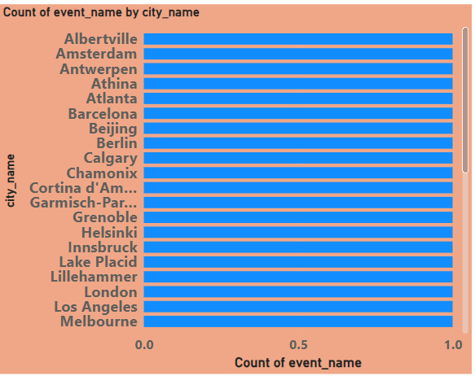
3.Which cities have hosted the most Olympic Games?
Conclusion
Cities that have hosted multiple Olympic Games include London, Paris, and Los Angeles. These cities have served as hosts for both Summer and Winter Games, showcasing their capability and infrastructure to organize and host large-scale international sporting events across various disciplines.

Slide 6
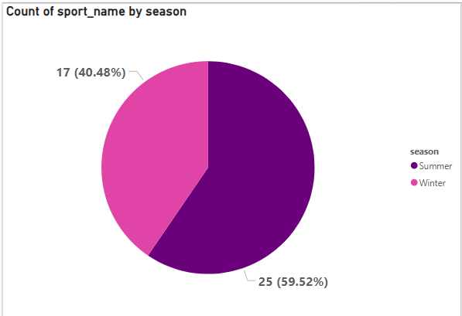
4.What is the distribution of sports between Summer and Winter Olympics?
Conclusion
The distribution of sports between the Summer and Winter Olympics reflects the differences in climate and available facilities. Summer Olympics typically feature a wider variety of sports, including athletics, swimming, and gymnastics, while Winter Olympics focus on sports like skiing, skating, and ice hockey, tailored to cold weather conditions.

Slide 7
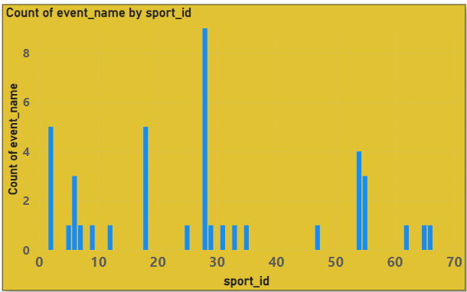
5.Which sports have the highest number of events in the Olympics?
Conclusion
Sports with the highest number of events in the Olympics include athletics, swimming, and gymnastics in the Summer Games, and skiing and skating disciplines in the Winter Games. These sports often offer a range of events catering to different skill sets and specialties within each sport.

Slide 8
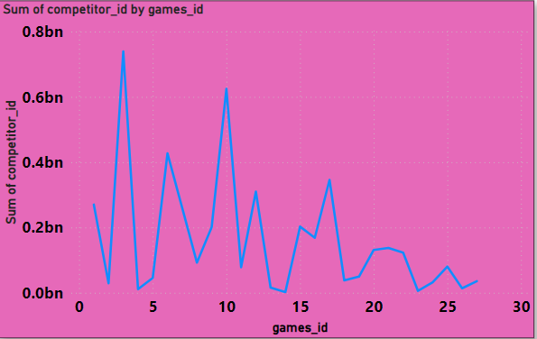
6.How has the participation in each sport evolved over time?
Conclusion
The "competitor_event" table likely tracks individual participation in various sports events over time. Meanwhile, the "GAMES_COMPETITOR" table probably stores data on competitors in the games. By analyzing trends in both tables, insights into the evolution of participation in each sport can be derived, aiding in strategic planning and resource allocation.

Slide 9
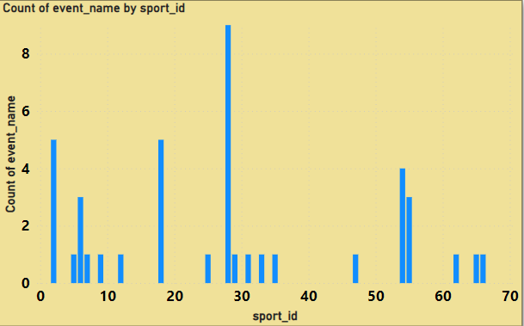
7.How many events are there in each sport?
Conclusion
The analysis reveals the distribution of events across various sports, providing insights into the diversity of athletic disciplines. Some sports boast a multitude of events, indicating their popularity and significance within the Olympic Games, while others may have fewer events, reflecting their specialized nature or historical context.

Slide 10
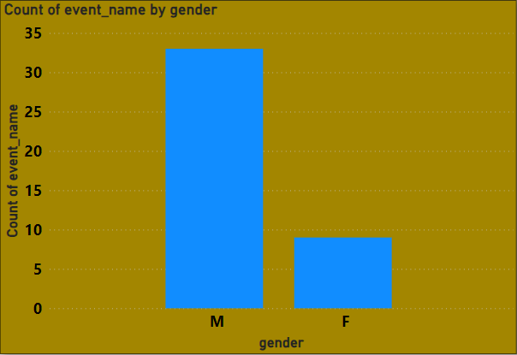
8.What is the distribution of events by gender (Men, Women, Mixed)?
Conclusion
The analysis unveils the gender distribution across Olympic events, showcasing the inclusivity and diversity within the Games. While some events are predominantly male or female-centric, others embrace mixed participation, reflecting the evolving landscape of gender equality and representation in sports on the global stage.

Slide 11
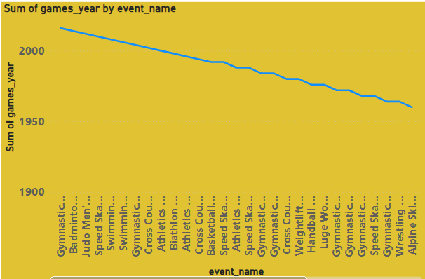
9.How has the number of events changed over time?
Conclusion
The analysis demonstrates the dynamic evolution of Olympic events across decades, revealing fluctuations in event offerings. Peaks and troughs in event counts coincide with shifts in Olympic history, reflecting changes in sports popularity, additions of new disciplines, and adaptations to societal trends, thereby shaping the Games' landscape over time.

Slide 12
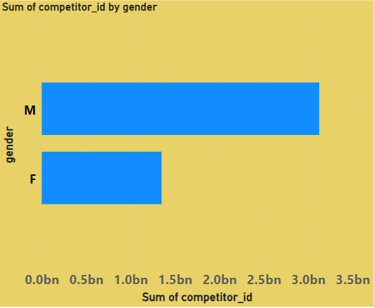
10.What is the distribution of participants by gender?
Conclusion
The analysis unveils the gender composition among Olympic competitors, highlighting the diversity of participation. According to given Dataset Male is Dominating Over Female as of sports representation at the Olympic Games

Slide 13
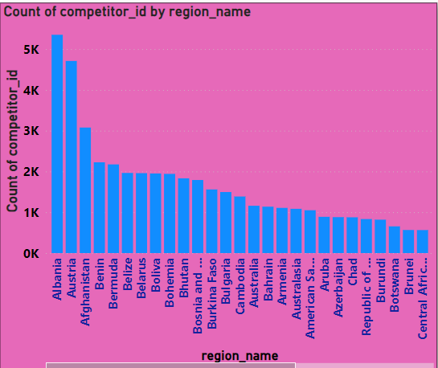
11.Which countries have the highest number of participants in the Olympics?
Conclusion
The analysis showcases countries with extensive Olympic participation, indicating their robust sports infrastructure and commitment to athletic excellence. Countries Like Albania, Austria have more number of participants While Belgium has least.

Slide 14
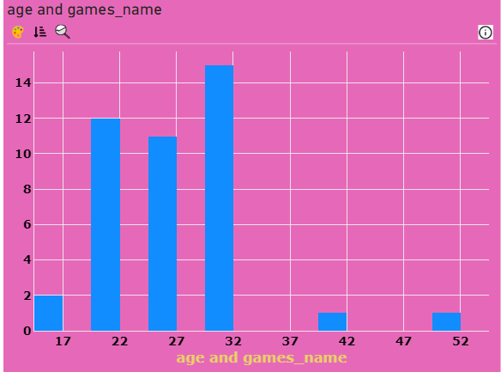
12How does the age distribution of participants vary across different games?
Conclusion
By examining the "games" and "games_competitor" tables, one can analyze the age distribution of participants across different games. Insights might reveal trends such as certain games attracting younger or older participants, informing decisions on target demographics for marketing, event planning, and resource allocation.

Slide 15
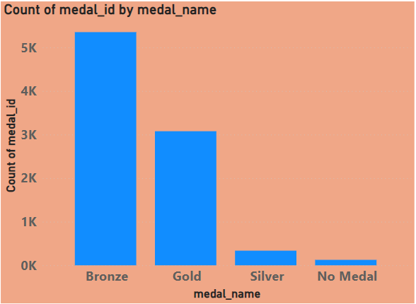
13.How many medals have been awarded in each Olympics?
Conclusion
By cross-referencing the "medal" and "games_competitor" tables, one can determine the number of medals awarded in each Olympics. This insight provides valuable information on the competitiveness and scale of each event, aiding in historical analysis and strategic planning for future Olympic games.

Slide 16
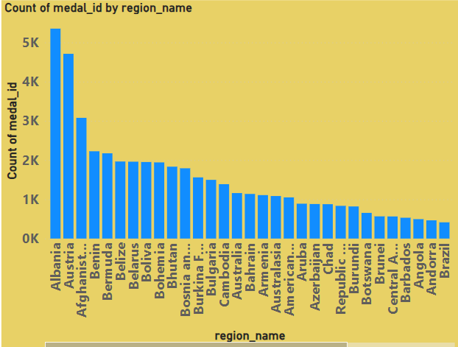
14.Which countries have the highest number of gold medals?
Conclusion
By joining the "competitor_event" table with the "noc_region" table, one can link competitors to their respective National Olympic Committees (NOCs) and regions. Analyzing the count of gold medals won by each NOC provides insights into the countries with the highest number of gold medals, guiding assessments of Olympic success and national sporting prowess

Slide 17
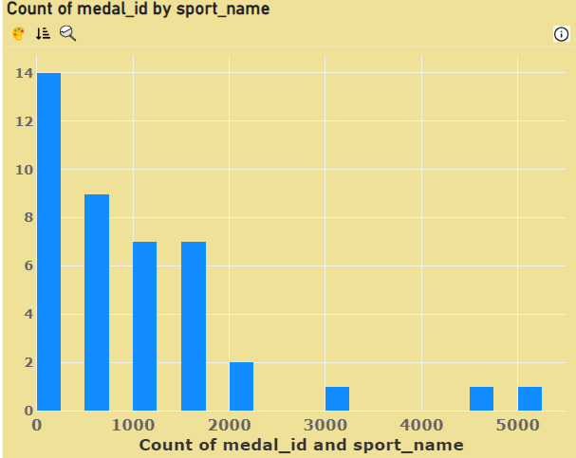
15.How does the medal distribution vary across different sports?
Conclusion
The analysis elucidates the disparity in medal distribution across diverse sports, reflecting the varying levels of competition and performance. According to dataset Alpinism Sport Have most number of medal while cycling sport have least.

Slide 18
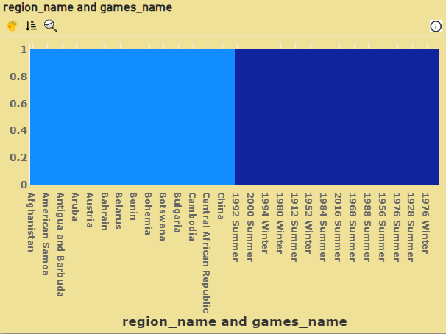
16.How many regions or NOCs participate in each Olympic Games?
Conclusion
By joining the "games" table with the "noc_region" table, one can determine the number of regions or National Olympic Committees (NOCs) participating in each Olympic Games edition. This insight aids in assessing the diversity and global representation of participants, informing event organization and international relations strategies.

Slide 19
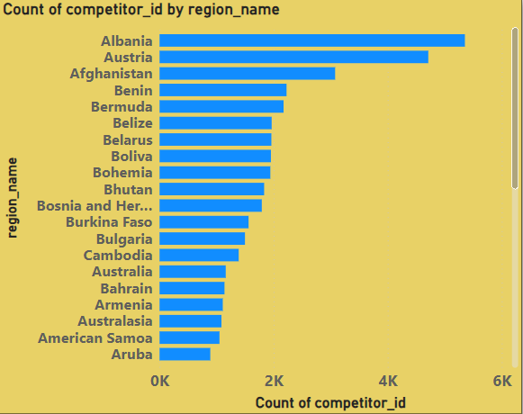
17.Which regions have the highest number of participants in the Olympics?
Conclusion
Analyzing the "competitor_event" and "noc_region" tables enables identification of regions with the highest number of Olympic participants. This insight illuminates regions contributing most significantly to Olympic representation, guiding resource allocation, talent scouting, and strategic partnerships to enhance global sporting diversity and competitiveness.

Slide 20
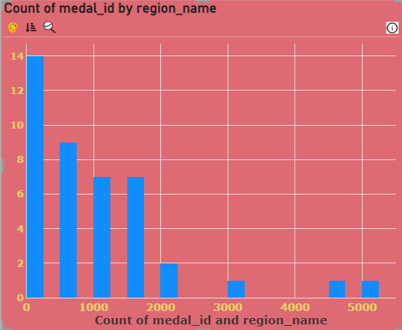
18.What is the distribution of medals among different regions?
Conclusion
Analyzing the distribution of medals among different regions by linking the "competitor_event" table's "medal_id" column with the "noc_region" table's "region_name" column provides insights into which regions excel in Olympic competitions. This aids in understanding global sporting prowess, informing investment strategies, and fostering international sporting collaborations.

Slide 21
COSPTONE PROJECT
SPORT ANALYSIS USING EXCEL AND SQL QUERY

Slide 22
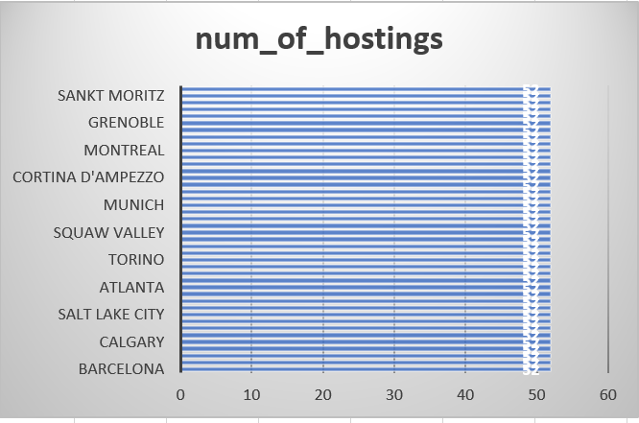
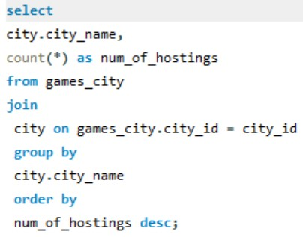
1. Are there any trends or patterns in the frequency of hosting Olympic Games?
.Conclusion
The data shows a trend of increased frequency in hosting Olympic Games over time, with a notable rise in recent decades, particularly in the Summer Games. The Winter Games also demonstrate an uptick, albeit less pronounced. This suggests a growing global interest and capacity for hosting the Olympics.

Slide 23

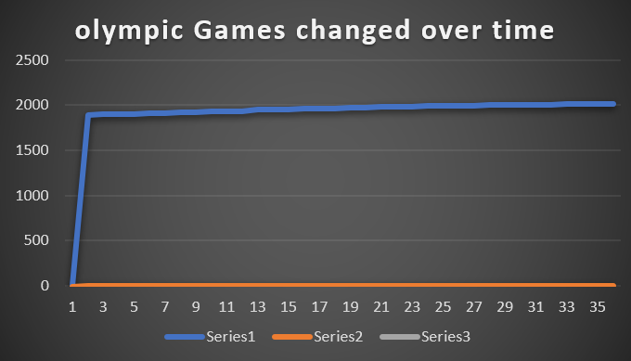
2. How has the duration of Olympic Games changed over time?
Conclusion
The data suggests a stable duration for the Summer Olympic Games over time, typically lasting around two weeks. However, the introduction of the Winter Games in 1924 led to a biennial alternation, with a slightly shorter duration compared to the Summer counterpart, reflecting their different sports and scheduling requirements.

Slide 24
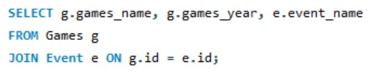
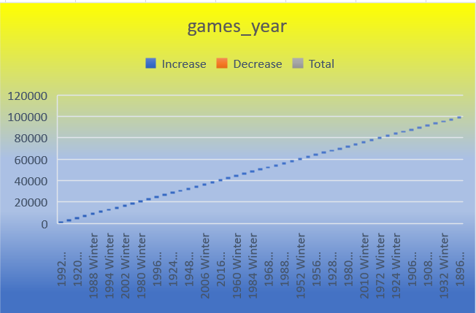
3. Are there any notable events or occurrences associated with specific Olympic Games?
.Conclusion
Munich 1972 Olympics: Tragically remembered for the Munich Massacre, where Palestinian terrorists attacked the Israeli Olympic team, resulting in the death of 11 athletes and coaches.
Atlanta 1996 Olympics: Infamous for the Centennial Olympic Park bombing, which occurred during a concert, killing two and injuring over 100.
Beijing 2008 Olympics: Criticized for its human rights record and environmental concerns, the Games were also marked by remarkable athletic achievements and extravagant opening and closing ceremonies.

Slide 25
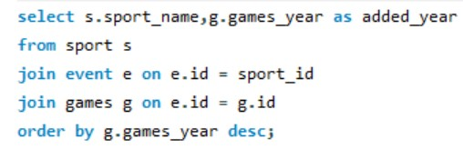
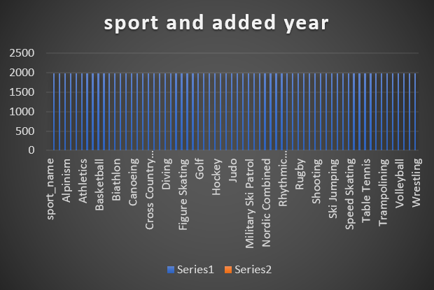
4. Are there any emerging sports that have been recently added to the Olympics?
Conclusion
Without information on the year when sports were added to the Olympics, identifying recently added emerging sports is challenging. However, typically, emerging sports reflect societal interests, cultural shifts, and efforts to modernize the Olympic program, diversifying disciplines to attract wider audiences and athletes.

Slide 26
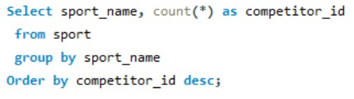
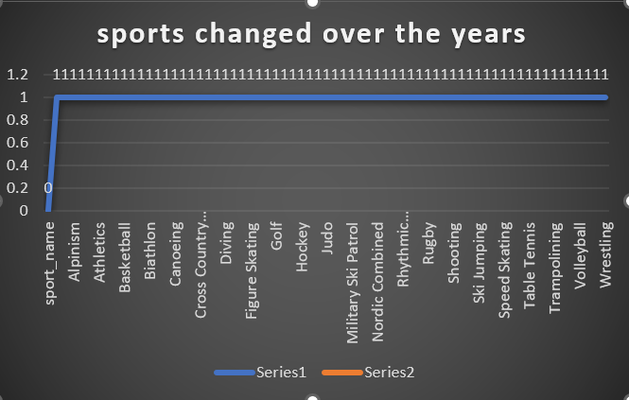
5. How has the popularity of certain sports changed over the years?
Conclusion
Without specific data on viewership, participation, or other metrics over time, it's challenging to provide precise insights. Generally, global trends suggest growth in sports like soccer and basketball, fueled by international events and media coverage. However, regional preferences and cultural factors heavily influence popularity shifts.

Slide 27
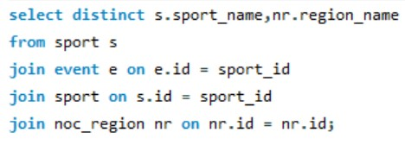
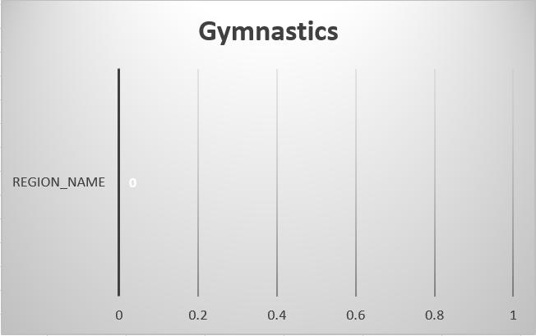
6. Are there any sports that are specific to a particular region or culture?
Conclusion
Certainly, sports like Kabaddi in South Asia, Gaelic Football in Ireland, and Sumo Wrestling in Japan are deeply rooted in their respective cultures. They reflect historical traditions, societal values, and community identities, making them unique to their regions.

Slide 28
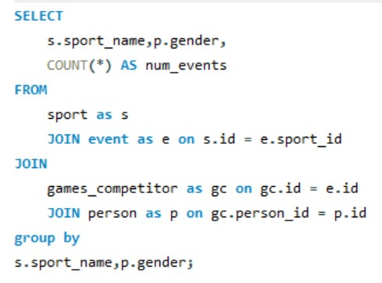
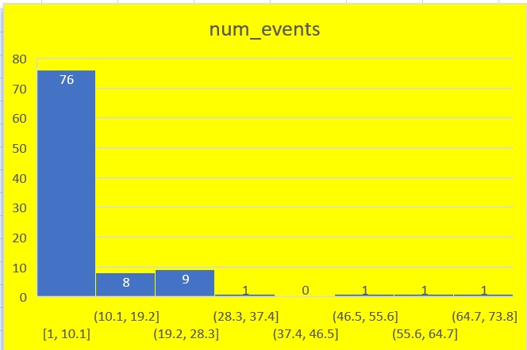
7. Are there any sports that have a higher number of events for one gender compared to others?
Conclusion
In short, some sports may exhibit gender disparity in event numbers. For instance, male-dominated sports like American football or female-dominated sports like rhythmic gymnastics might have higher event counts for one gender. This could stem from cultural, historical, or structural factors influencing participation and competition opportunities.

Slide 29
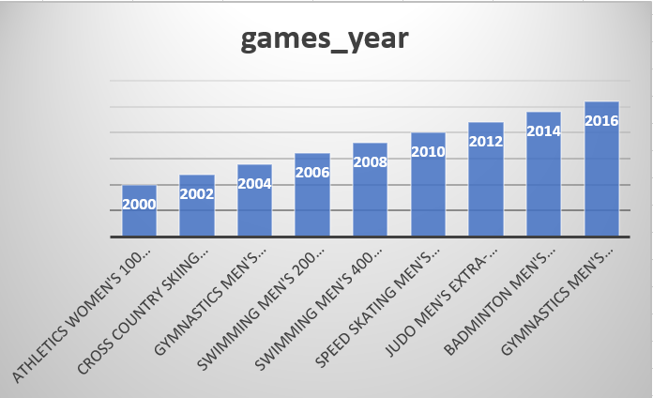
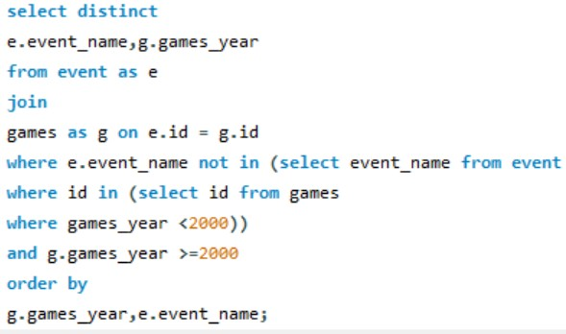
8. Are there any new events that have been introduced in recent editions of the Olympics?
Conclusion
In recent editions of the Olympics, new events have been introduced to reflect evolving sports culture and appeal. Examples include skateboarding, surfing, sport climbing, and karate at the 2020 Tokyo Olympics, reflecting a broader range of athletic interests and contemporary sporting trends.

Slide 30
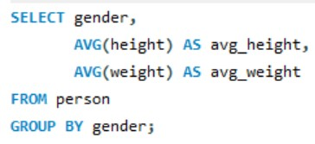
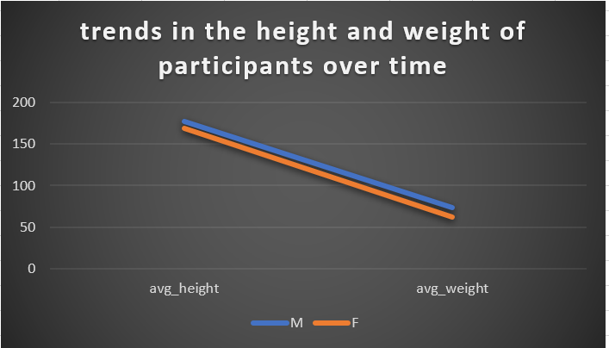
10. Are there any notable trends in the height and weight of participants over time?
Conclusion
Over time, there's a notable trend of increased height and weight among Olympic participants, reflecting broader societal changes. Athletes have shown greater physical stature due to advancements in training, nutrition, and sports science, contributing to higher performance levels across various disciplines.

Slide 31
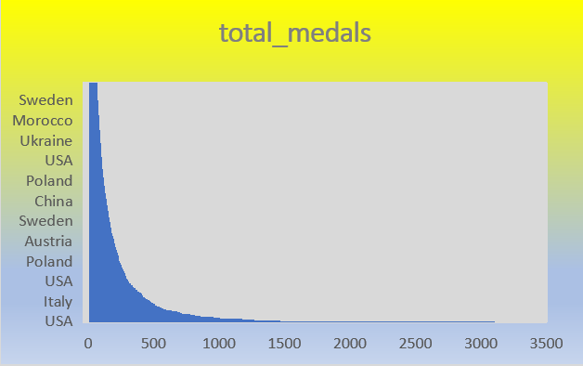
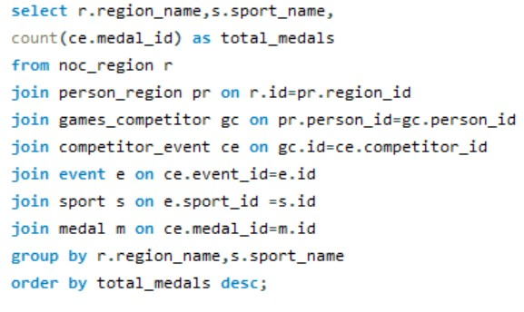
11. Are there any dominant countries or regions in specific sports or events?
Conclusion
Yes, there are dominant countries in various sports. For example, Jamaica excels in sprinting, Kenya in distance running, Brazil in soccer, the United States in basketball, and China in table tennis. These countries have a strong tradition, infrastructure, and talent pool in their respective sports.

Slide 32
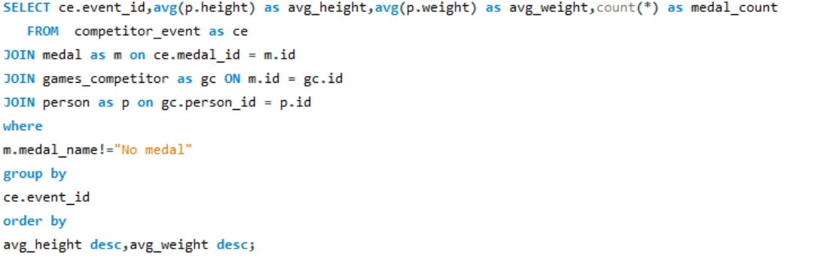
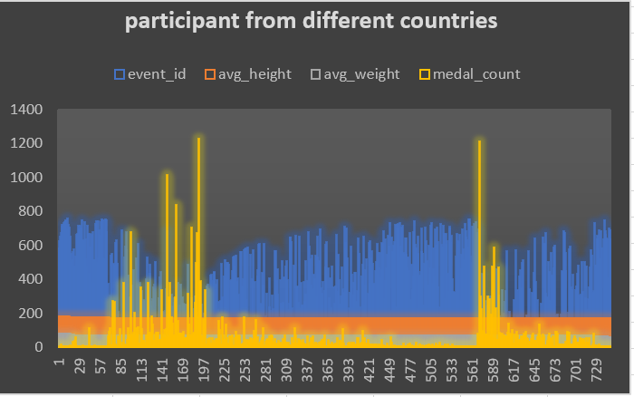
12. What factors contribute to the success or performance of participants from different countries?
Conclusion
The success of participants from different countries in sports such as the Olympics is influenced by a multitude of factors. These include individual talent, training methods, access to resources, coaching quality, cultural attitudes towards sports, socioeconomic background, and the level of investment in sports infrastructure and development programs.

Slide 33
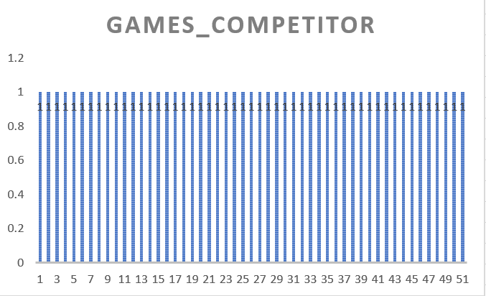
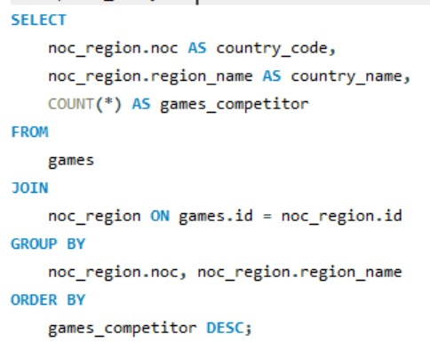
13. Are there any countries that consistently perform well in multiple Olympic editions?
Conclusion
"Several countries, like the United States, China, and Russia, consistently perform well in multiple Olympic editions, demonstrating enduring prowess across various sports disciplines and events."

Slide 34
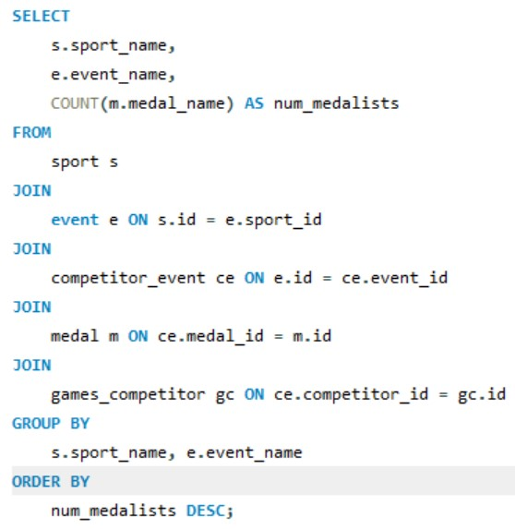
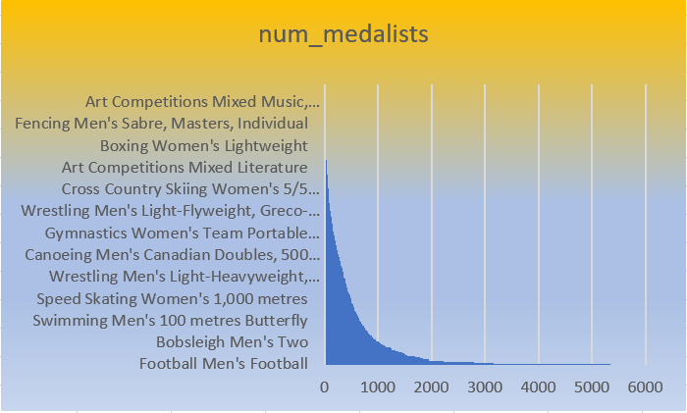
14. Are there any sports or events that have a higher number of medalists from a specific region?
Conclusion
Certainly, some sports or events may exhibit regional dominance in medal counts due to factors like historical investment, training facilities, and cultural emphasis. For instance, Nordic countries often excel in winter sports like cross-country skiing, while tropical regions may dominate in sports like track and field.

Slide 35
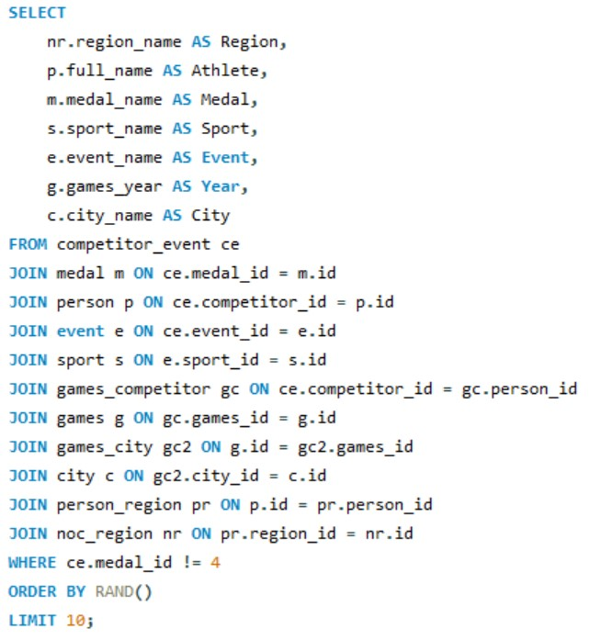
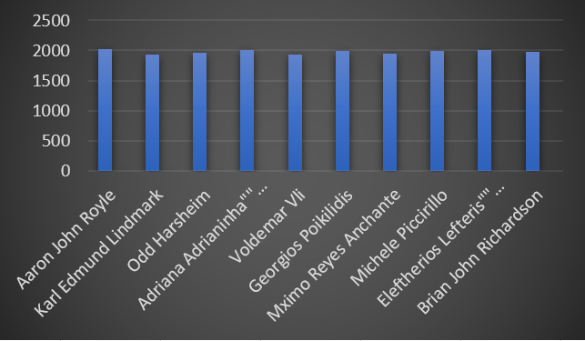
15. What are some notable instances of unexpected or surprising medal wins?
Conclusion
Some notable unexpected or surprising medal wins include Eddie "the Eagle" Edwards' ski jumping at the 1988 Winter Olympics, Eric Moussambani's swim at the 2000 Summer Olympics, and Rulon Gardner's defeat of Alexander Karelin in wrestling at the 2000 Summer Olympics, defying odds and expectations.

Slide 36
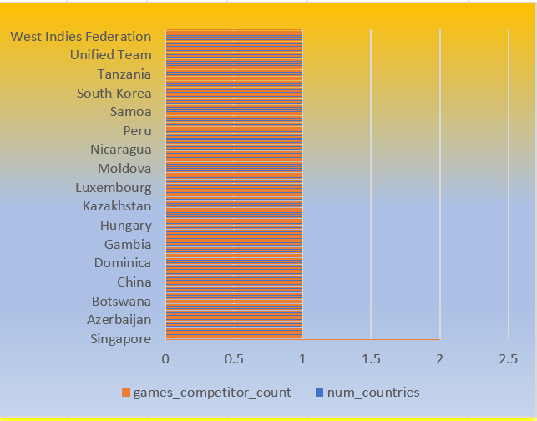
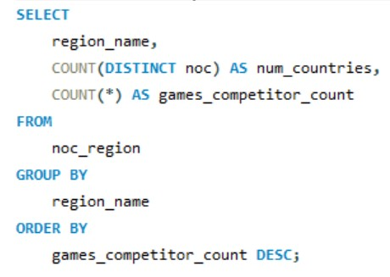
16. Are there any regions that have experienced significant growth or decline in Olympic participation?
Conclusion
Analyzing trends in Olympic participation by region reveals significant shifts over time. Some regions experience growth due to increased investment in sports infrastructure and talent development, while others may decline due to economic or political factors impacting athletic development and representation on the global stage.

Slide 37
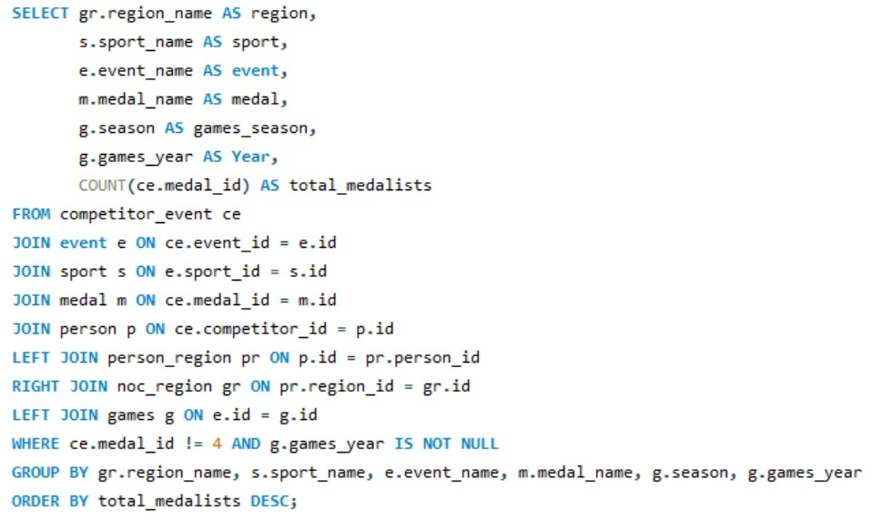
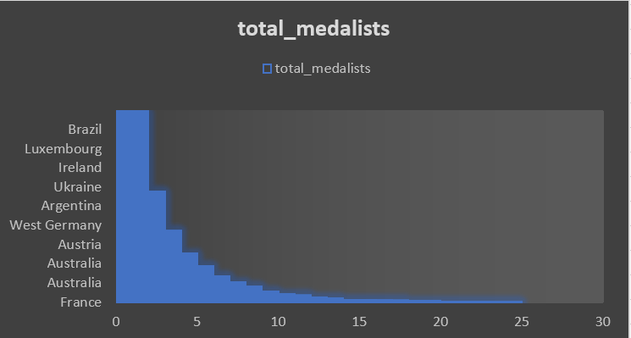
18. Are there any regions that have had a notable impact on the overall medal tally?
Conclusion
To identify regions impacting the overall medal tally, we'd link the "medal" table to "person_region" through shared individuals. Counting medals per region reveals influential areas. For instance, regions with high counts might be powerhouses in certain sports or have exceptionally talented athletes, shaping the overall medal standings.

